Slide 1
Summer Overview
History, Mission & Vision of the Urban Scholars Program (USP)
Calendar
Why Summer Matters
Programming Framework - ACT
Teaching Assistant/Team Captain (TA) Roles
What sets USP apart?
Scenarios/Activities
Questions

Slide 2
USP Mission and Vision
We are a year-round college preparation program for academically talented and focused low-income/first-generation BPS students in grades 7-12 who desire a college education.
We work with specific “partner schools” to recruit students.
We seek to cultivate life-long learners who lead healthy and productive lives impacting the local and global community in positive ways
We prepare students for college by
Ensuring their academic records are strong
Ensuring they have college-ready skills
Ensuring they are developing into thoughtful, well-rounded, success-oriented individuals

Slide 4
Why Summer Matters
Closing the Achievement Gap and Expanding Opportunities

Slide 6
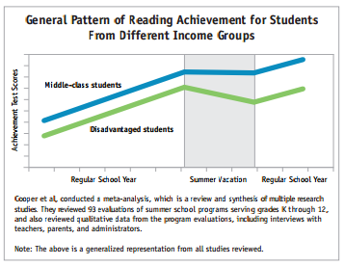
Reading Matters!

Slide 7
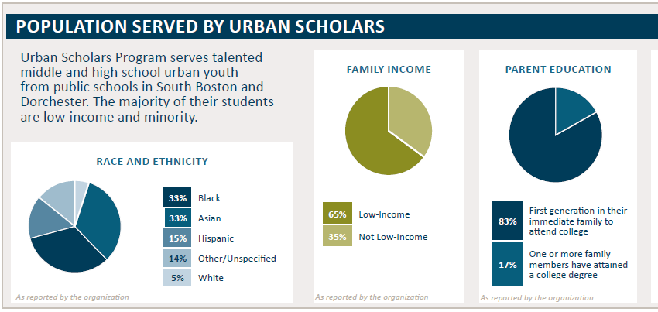

Slide 8
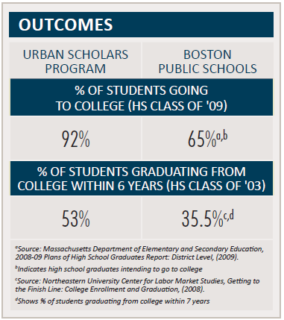

Slide 9
Fundamentals
Safety
Communication
Intentional Inclusion
High Expectations
Ask Questions
Collaboration and Teamwork
Enthusiasm, energy
Self-awareness
Notes:
TA Roles

Slide 10
Keys to Success – Classroom Assistant
Be on time and on board (routines, rules, etc.)
Be proactive and engage students
Be excited about the subject matter and activities
Model meeting high expectations and effort determines success
Communicate w/instructor– ask questions, express concerns, make suggestions
Notes:
TA Roles

Slide 11
Keys to Success - Team Leader
Organized, planned, communicative = confident
Know names ASAP
Connect 1-1 in week 1
Intentional Inclusion
Student leadership
Be silly, fun, yourself
Emphasize Habits of Mind
Routines
Shout Out’s
Call to Attention
Notes:
TA Roles
The formulation of a problem is often more essential than its solution, which may be merely a matter of mathematical or experimental skill. … To raise new questions, new possibilities, to regard old problems from a new angle, requires creative imagination and marks real advances.—Albert Einstein

Slide 12
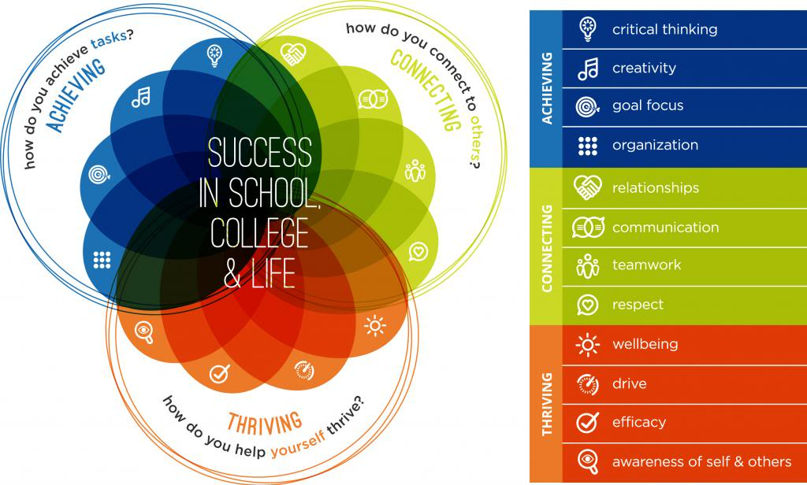
College-Preparation at Urban Scholars

Slide 13
Exploring A-C-T
Group 1 - Achieving
Bryan, Stephanie V, David
Group 2 - Connecting
Moi, Abby, Erimel, Kevin
Group 3 – Thriving
Hannah, Jonathan, Amelia, Suamy

Slide 14
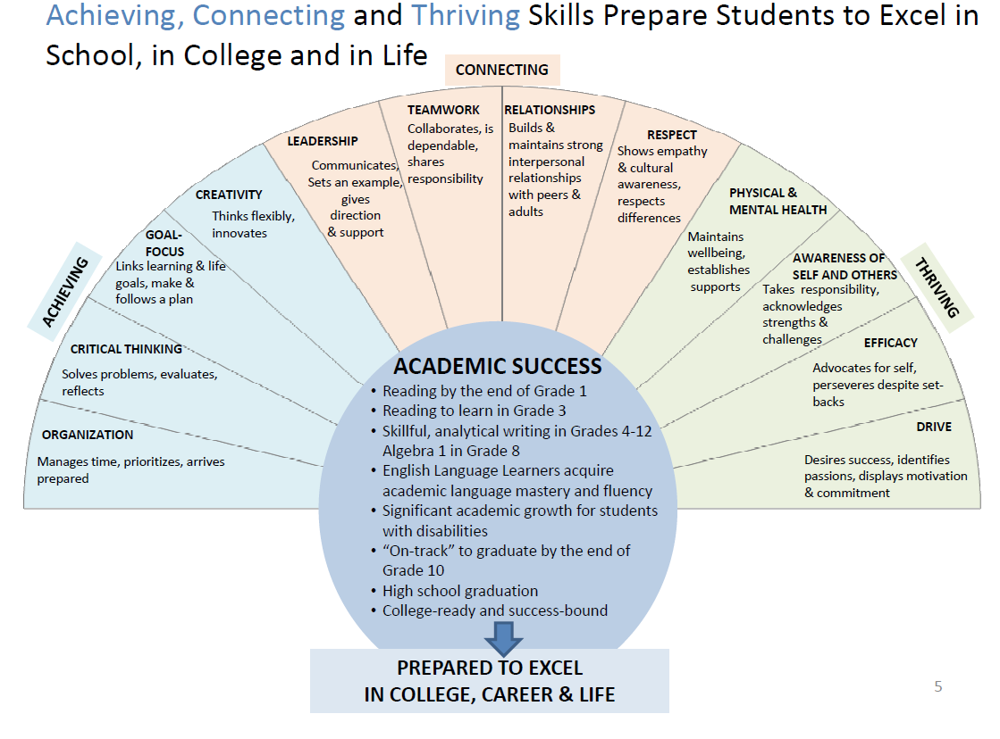

Slide 15
Your Task
Self-assess: where are you strong? Where are you developing?
In your experience, how have you grown in one or more categories as a result of being influenced by a teacher, mentor, family member, counselor, friend, etc.
How and why were they effective?

Slide 16
In your groups, please discuss:
How can we make use of these lessons in our work with our scholars this summer?
Write findings on chart paper
Gallery Walk w/post-its
Share out when finished.

Slide 17
Day 3 - Intern Impact
10-10:15 – A day in the life…
10:15-11:00 - cultural awareness, sensitivity and teachable moments
11:00-11:30 – UHS presentation re: Epipen and Safety procedures
11:30-12:30 – Handbook and scenarios w/ACT
12:30-1:00 – Lunch
1:00-2:30 – Travel to and finish at ICA

Slide 18
A Day in the Life of a USP Intern – Teaching Assistant
8:30 – Arrive at USP
Prepare classroom (supply bin from office)
Greet students @ bus, in common areas
Help with check-in as needed
Engage students, play a game, ask about classes
Move students to class @ 8:50
Class Breaks: Monitor hallways, teachable moments, move students along
AM Break (11:30-:40) – Same as above, keep students near Wheatley

Slide 19
 | M | T | W | TR | F
9:00-10:10 | A | B | B | A | B
10:10-11:20 | B | A | A | B | A
10 Min. Break
11:30-12:40 | C | C | C | C | C

Slide 20
A Day in the Life of a USP Intern – Team Captain
12:40-1:15 - Lunch: 4 in Café, 4 outside
Check-in @ office as needed
1:15-1:30 - Team Meeting 1
Attendance, disseminate info, get ready for PM, get psyched!
Community Meetings in Lipke (Science) every Mon. (1:15-1:45)
ICA Group Leaves at 1:15 from CC
1:30-4:30 - Activities, competitions, workshops
4:30 - Team Meeting 2
Take attendance, give info, feedback, shout outs
4:45 - Dismissal
Until 5:15 - Office for debrief

Slide 21
Effective Supervision
Communicate w/Co-Captain
Communicate w/Students
Expectations re: behavior, safety
Never send students away on their own
Motivate participation
Step-back, survey the scene
Monitor your own participation
Be always engaged

Slide 22
Notes:
Academics at us

Slide 23
Academics @ USP
Project-Based Learning
Student-centered and student-driven
Inquiry, collaboration, real-world relevance, critical/creative thinking, performance
Essential Questions + Habits of Mind
Active and interactive learning
Rigor
Metacognition
Effort, engagement, high expectations

Slide 24
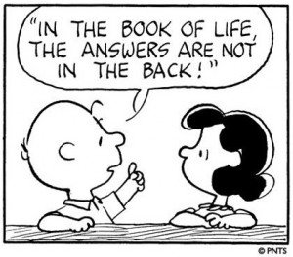

Slide 25
Preparing the learning environment (i.e. gather materials before class, return them at the end, grab a resource during class if needed)
Being fully and actively engaged in the lesson, whatever your role on a particular day is, and be communicative with the teacher – assuming the position of learner and leader of learners
Being consistent with classroom/teacher and program-wide policies/expectations
Modeling high expectations, enthusiasm for learning, and challenging students to excel
Communicating student issues with core staff
Ensuring hallways are safe, quiet, and orderly between classes and during break
Ensuring scholars are moving to class on time

Slide 26
Culture, Inclusion, and Strong Relationships

Slide 27
Cultural Sensitivity
Cultural sensitivity means being aware that cultural differences and similarities exist and have an effect on values, learning, and behavior.
-Stafford, Bowman, Eking, Hanna, and Lopoes-Defede (1997)

Slide 28
Pre-Assessment
What are some of the different cultures at my school (3-5 cultures)?
What characteristics come to mind when I think of each group?
Where did these impressions come from?
How do I treat people based on these assumptions?

Slide 29
Group Activity
With your group, discuss a time when someone had made an assumption about you. This assumption might have been based on a group you belong to – ethnic, religious, gender, age, class, sexual orientation, or otherwise.
How did it make you feel? Why?
What did you/What did you want to say to this person?

Slide 30
Digging Deeper
Everything we do regarding time, personal space, body language, voice volume, small talk, eye contact, hygiene, and eating is shaped by our culture.
Do not interpret the behavior of others through the eyes of your own culture.
Do be aware of how much culture affects language acquisition, ideas, opinions, and behavior. Do practice an asset-based approach!

Slide 31
Sensitivity and Awareness
Language
Dress
Customs and culture (i.e. eye contact)
Income
Family story
Sexual Orientation
Religion – i.e. Ramadan (6/28-7/28)
Show interest and model acceptance
Beyond respect/tolerance: appreciating differences

Slide 33
What We Can Do
Demonstrate a positive attitude regarding cultures. Practice asset-based thinking.
Plan activities that are purposely inclusive and help make students comfortable.
Cultivate a team culture that fosters feelings of acceptance.
Address intolerance, stereotypes, and prejudice without delay.

Slide 34
Cont’d
Focus on the uniqueness of each individual.
Speak about your experience and avoid generalizing or assuming.
Model inquisitiveness and appreciation.
ASK questions!
Don’t expect one member of a group to speak for all members of the group.
Demonstrate your expectations and give positive and constructive feedback!

Slide 35
Activity – Inclusion/Cultural Awareness Scenarios
Groups: Count off
Review the scenario and problem-solve with your group.
Describe a variety of action steps you would take to improve each situation. Write on blackboard.
Gallery Walk w/comments

Slide 36
Student Conduct
High Expectations – the BEST versions of ourselves
Core Expectations:
Respect
Community
Engagement
Excellence
Achieving – Thriving - Connecting

Slide 37
Mandatory Reporting – report to Kevin
Confidentiality (medical info, issues)
Communication
Electronic
In-person
Cell-phones
Physical and Verbal Conduct
Bullying
Sexual harassment
Appropriate setting

Slide 38
Scenarios
New groups
Keeping the ACT framework in mind, how would you handle these situations/teachable moments
Be sure to think age/gender-appropriate and practice cultural awareness

Slide 39
In Case of Emergency – Plan w/Co-Captain
Modest Injury
Take to UHS (if mobile)
Call Suamy/Office Immediately
Severe Behavior (Fight)
Reduce Crisis (BOA)
Call Suamy/Office Immediately
Severe Behavior (Conduct)
Remove Student to Office
Conference with Staff
Return to Action
Escort Student(s) to Office Separately
Stay with Student
Missing Student
Conference w/Co-Captain
Call Suamy/Office Immediately

Slide 40
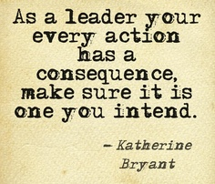
Notes:
Concl

Slide 41
Notes:
concl2

Slide 42
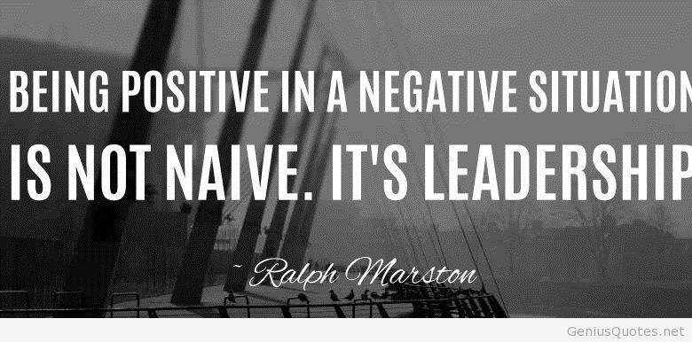
Notes:
Concl4

Slide 43
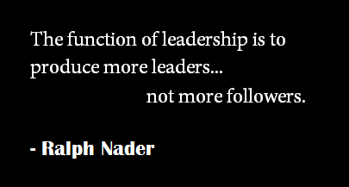
Notes:
Concl5

